Slide 1
유전알고리즘을 이용한 병렬프로그래밍
2017270986
황창국

Slide 2
Parallel Genetic Algorithms
The father of the original Genetic Algorithm was
John Holland who invented it in the early 1970's.
Is a search heuristic that mimics the process of natural evolution.
The idea with GA is to use this power of evolution to solve optimization problems.
Although randomized, GAs are by no means random.
Exploit historical information to direct the search.

Slide 3
Why Parallel GA ?
GA’s are usually more time consuming.
Not too fast.
Traditional algorithms can handle only
“well behaved” functions.
Algorithms may converge to sub-optimal solutions.

Slide 4
Parallel GA a Solution
Roughly speaking, there are two kinds of PGAs
-One is to speedup GAs through parallelization without changing their properties (say, the convergence).
Another one is to change GAs to make them more suitable for parallel computation, and at the same time, to make them better (say, to converge more quickly, to prevent the evolution from pre-mature problem, and so on).

Slide 5
Algorithm implementation
Expression of the gene, which is a data structure, to solve.
Some sort of string matching.
The goal is to represent the same gene as the string entered through the evolution process.

Slide 6
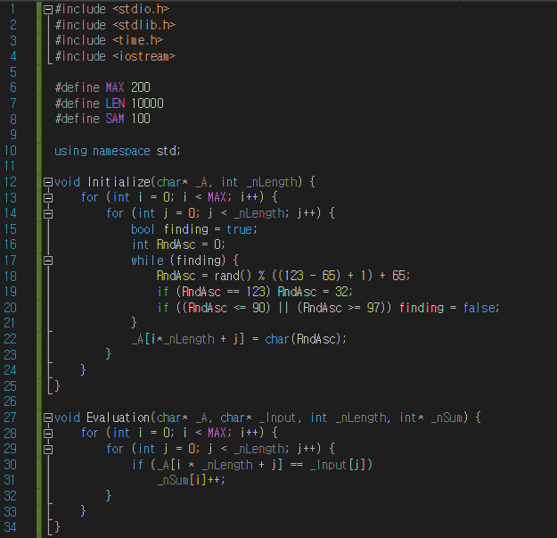
CPU implementation / C++
The initialization function is a function that takes a character array A and an integer variable nLength as parameters, and stores an array (gene) in an array.
2. (nLength*MAX) alphabet according to ASCII code, Space ('‘) characters are randomly generated.
3. The generated random characters are stored in array A.
CPU Source

Slide 7
CPU implementation / C++
4. The Evaluation function is a step to evaluate, that is, score a gene (string).
Considering that the array A represents a matrix with MAX rows and nLength columns as a one-dimensional array, if the characters in A and the input characters are the same, then increase the nSum value.
nSum[i] is an evaluation of the score of the random character string in the i-th row of array A.

Slide 8
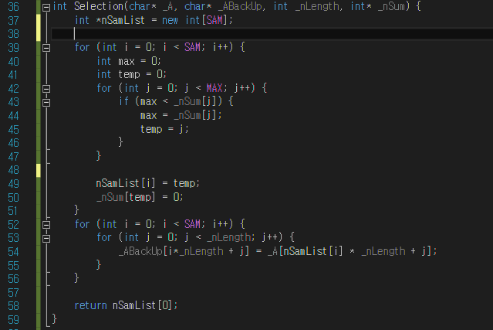
CPU implementation / C++
The selection function is the step of selecting a dominant gene, that is, selecting a character string that is evaluated with a high score.
2. Create nSamList as many as SAM of the number of genes to be sampled, and store as many SAMs as the nSum value in descending order.
3. The character of array A corresponding to the index of nSamList is stored in BackUp as an array.
4. Through this process, superior genes (higher scores) survive later.
CPU Source

Slide 9
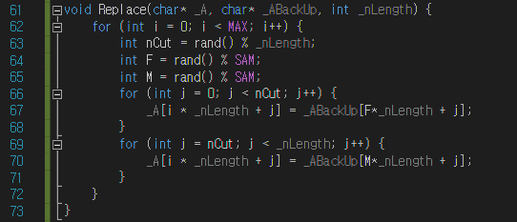
CPU implementation / C++
The Replace function is the step of generating offspring genes through parent genes.
The integer part (F) and the parent (M) are randomly determined in a string row to be selected as the parent or parent.
3. The integer nCut randomly determines how many genes are inherited from the parent.
4. The new offspring inherits strings as many as nCut left from F gene and as much as nLength-nCut from M gene and stores them in the A sequence.
CPU Source

Slide 10
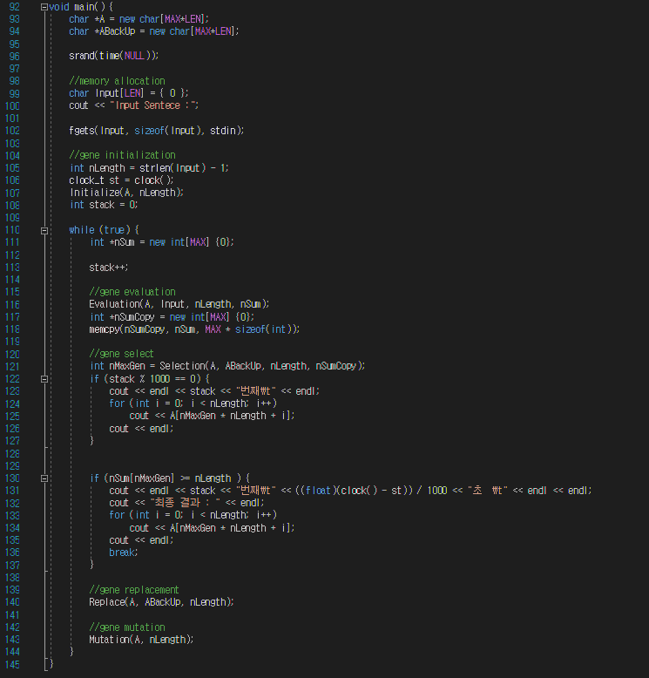
CPU implementation / C++
Execute the algorithm through the Main function.
Allocate the necessary array and input the target string (Input Sentence).
3. Initialize the initial gene through the Initialize function.
After initialization, it goes through the steps of Evalution, Selection, and Replace through an infinite loop and outputs the intermediate result in the 1000th execution unit.
If the same result as the input string is displayed, the final result is output and the loop is terminated.
CPU Source

Slide 11
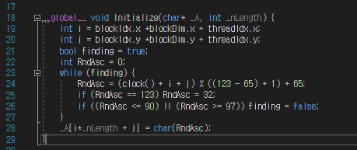
GPU implementation / CUDA
GPU Source
TILE_WIDTH is set to 32 (size of one block: 32*32).
The thread index is set to i and j.
3. The CPU generates random characters sequentially generated through a loop and stores them in array A..

Slide 12
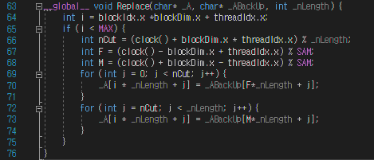
GPU implementation / CUDA
GPU Source
"Replace" is executed row by row, only i, which is the thread index x, is set.
In the CPU, nCut, F, M, which were sequentially generated from 0 to MAX rows, are set in parallel through a loop.
3. Store child strings in array A.

Slide 13
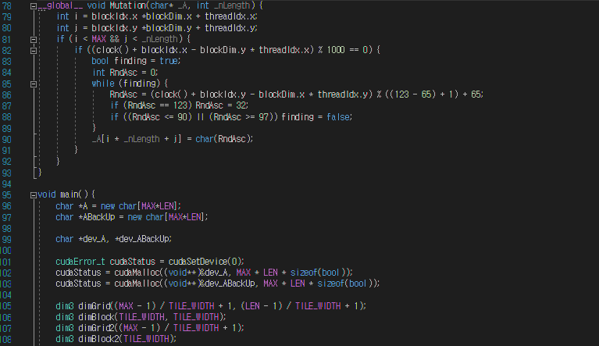
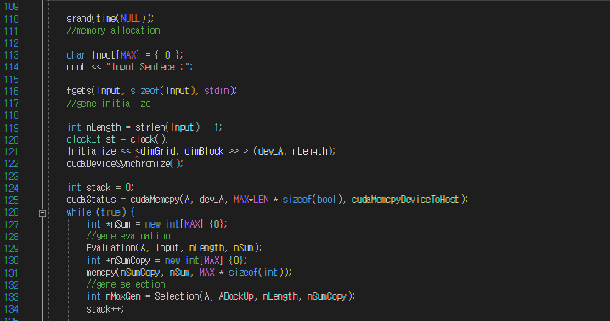
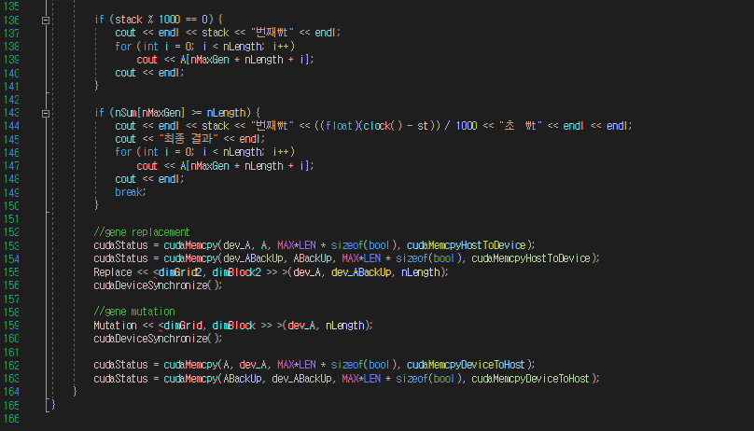
GPU implementation / CUDA
GPU Source
Allocate the required arrays and global memory of the GPU.
dimGrid2 is created in 1D and dimGrid is created in 2D.
dimGrid2 is used for the Replace function using only the x thread index, and dimGrid is used for the remaining kernel functions using the x, y thread index.
Call the Initialize kernel function to generate random characters and create an array.
In an infinite loop, it repeatedly executes the evaluation, selection, and replace (kernel function) functions, and outputs the intermediate result in the 1000th unit.
When the same result as the input string is displayed, the final result is output and the loop is terminated.

Slide 14
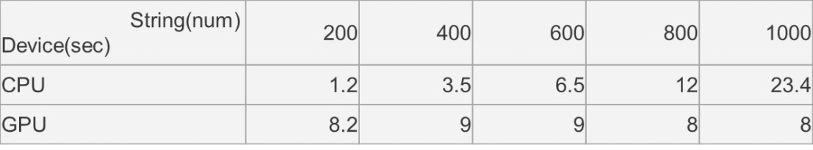
CPU(C++) vs GPU(CUDA) performance
The CPU time required increases exponentially as data increases linearly.
The GPU takes almost a certain amount of time until the number of data becomes larger than the number of threads (CUDA cores).
CPU : Intel I5-8500
GPU : Gigabyte RTX 2060 D6 6GB

Slide 15
Thank you

